Slide 1
FPGA Packet Filter With Custom Ethernet MAC and Webserver on RISC-V
Undergraduate thesis semiar
Student : Matthew Gilpin 45801600
Supervisor: Dr Matthew D’Souza

Slide 2
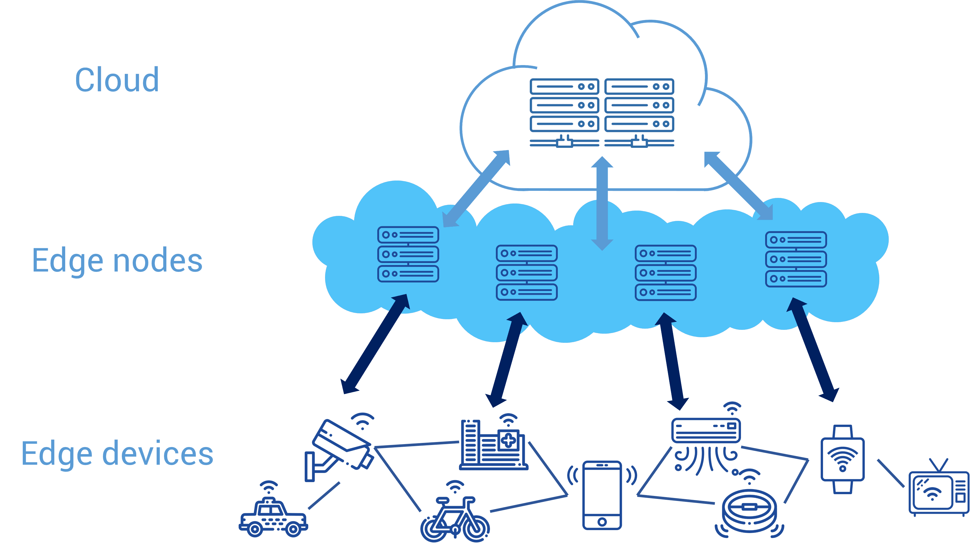
Edge networks and Security
Move computing to the edge – closer to the source of data.
Low power, highly distributed systems.
Increasing security is needed
‘5 tuple’ fields to filter on - Source IP, Dest IP, Source Port, Dest Port, Protocol

Slide 3
Firewalls
Talk about why 5 tuple is good and what its limitations are.
Packet filter is a subset of firewalls
Some firewalls can do things like deep packet inspection
Firewalls can be done in hardware or software

Slide 4
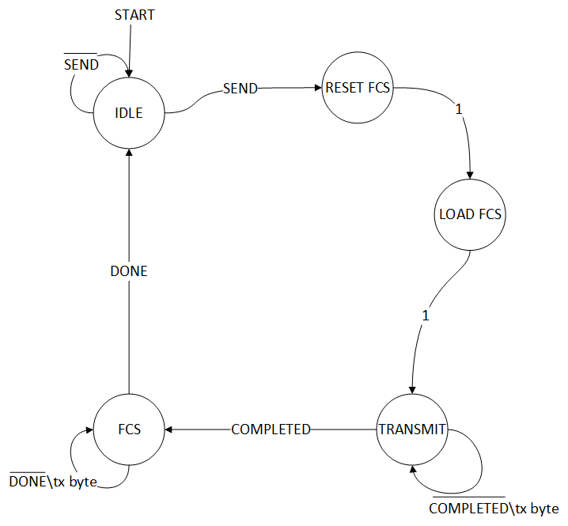
FPGAs
Field Programmable Gate Array
Custom logic - Define own architecture - Allows for optimisation -Allows for parallelisation
Use case in Ethernet MACs - Calculate FCS (CRC32) on the fly - Filter data at wirespeed - All while processor can be doing other things - Equates to low latency and high throughput.
System on Chips (SoC) – Integrate custom hardware with existing hardware/IP (eg, processor cores)
FPGAs
Ethernet Transmit FSM

Slide 5

RISC-V
Royalty-free Instruction Set Architecture (ISA)
Can be used to handle more complex but low priority tasks.
Used for running webserver
Easier to write software than hardware – faster development cycle

Slide 6
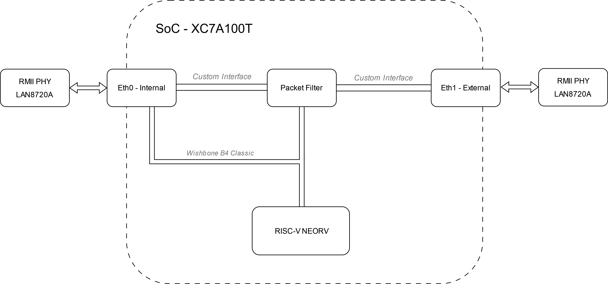
Implementation
Using neorv32 – RISC-V softcore written in vendor agnostic VHDL
Custom Ethernet MAC
FreeRTOS with FreeRTOS Plus TCP stack
Currently at 50Mhz, intend to be 75Mhz or 100Mhz.
Why an FPGA

Slide 7
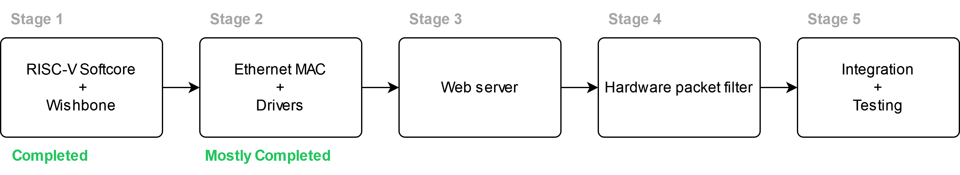
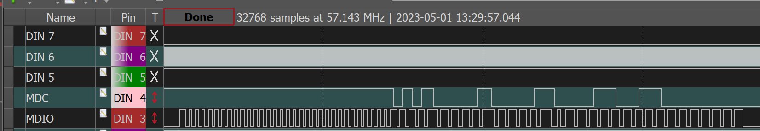
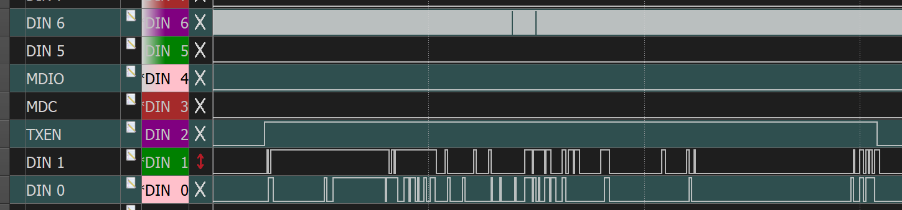
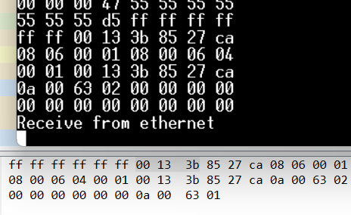
Progress

Slide 8
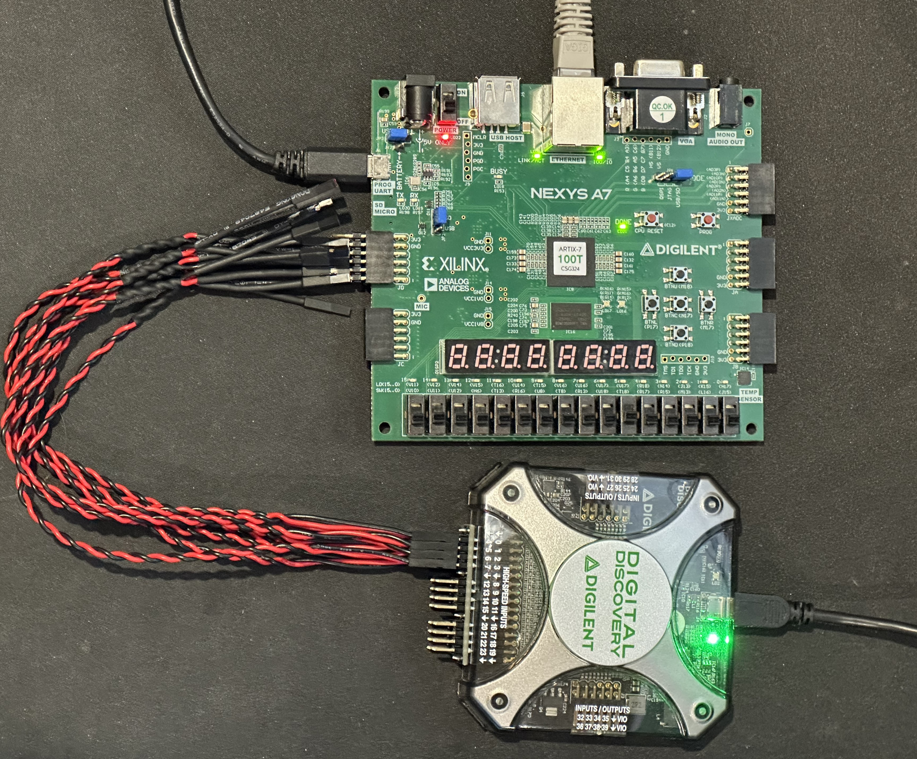
Testing
Testing with a Digilent Digital Discovery – 800MSa/s
Also using simulations in Vivado to reduce time waiting for synthesis

Slide 9
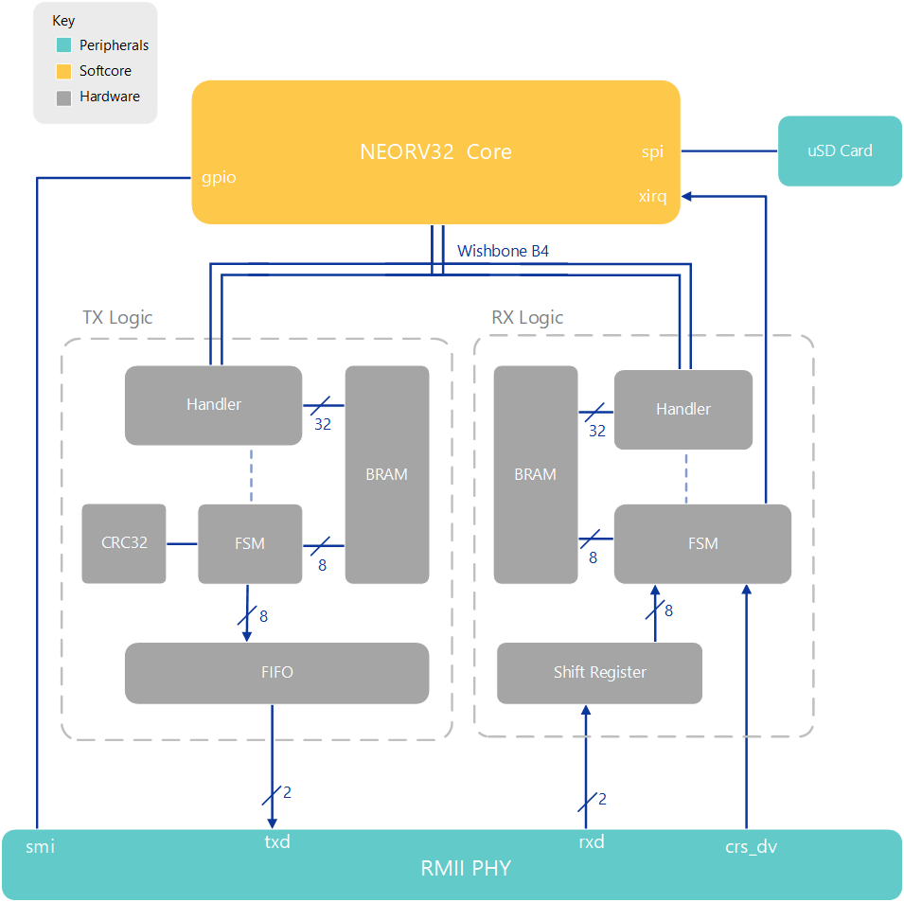
Current hardware state
Handler deals with memory and wishbone
FSM handles the data manipulation
FIFO and Shift Register used to cross clock domains
Packets get built and stored in BRAM
FCS (CRC32) calculated on the fly

Slide 10
Tricks
Talk about receive logic and tie into how that could be used in the pattern matching – learned in coding interview

Slide 11
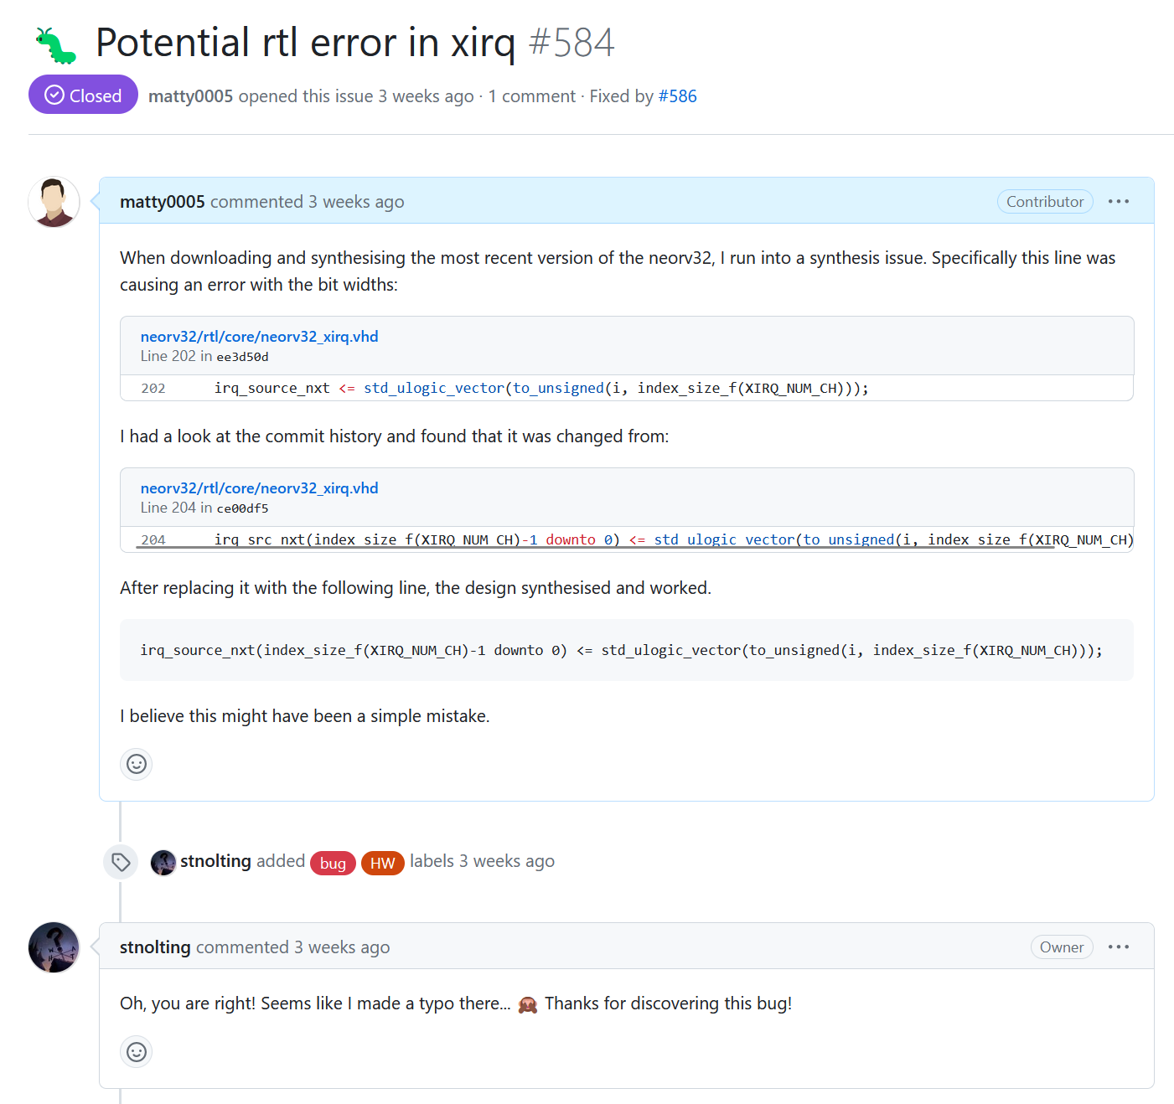
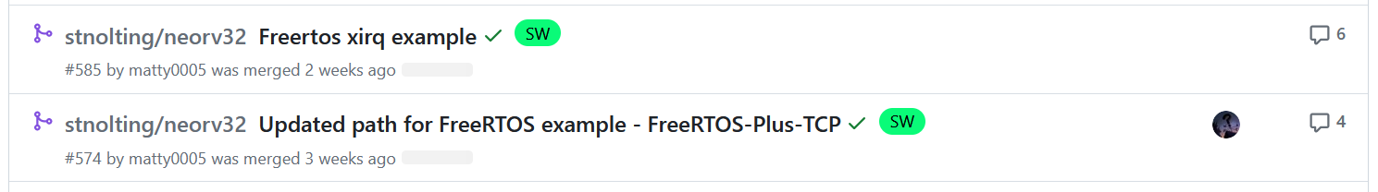
Contributions – neorv32
Detected hardware errors + added external interrupts with FreeRTOS example.

Slide 12
Project plan
Complete Receive logic
Fix up transmit logic to properly send out of RMII PHY
Create simple webserver
Create hardware filtering mechanism
Tie that into the existing system.

Slide 13
Contact
Matthew Gilpin
m.gilpin@uq.edu.au

